Slide 1
Computer Science 20
branching

Slide 2
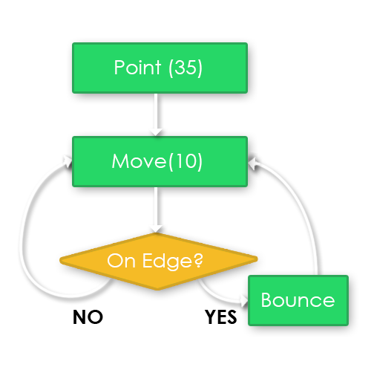
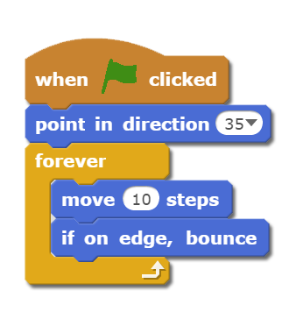
Sequences aren’t enough
Purely sequential programs are often insufficient to tackle complex tasks.
Second major component of programs are branching (or decision-making) structures.

Slide 3
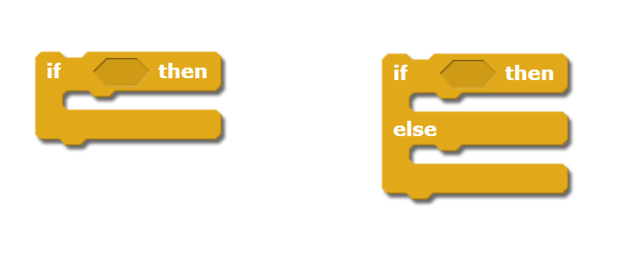
Scratch: Two Types of Branches
Notice that there is a missing shape. This missing shape needs to be a block that can either be TRUE or FALSE (Boolean)

Slide 4
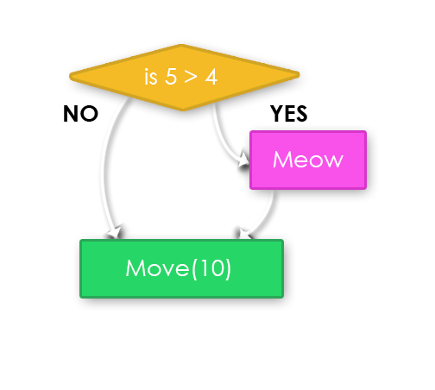
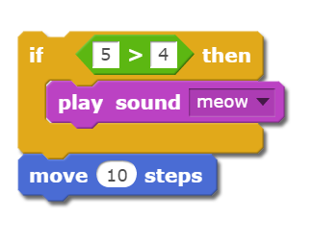
IF
Program looks at the condition (in green) and determines whether it is TRUE or FALSE.
If TRUE, any scripts inside the IF block will run.
If FALSE, it will skip the blocks inside the IF and carry on.

Slide 5
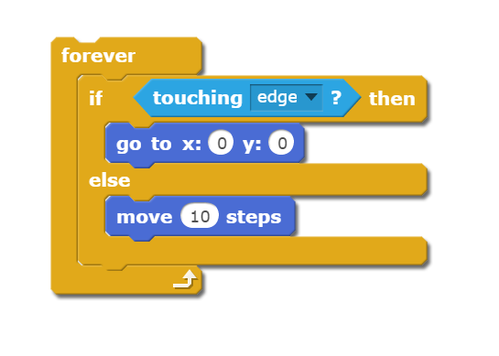
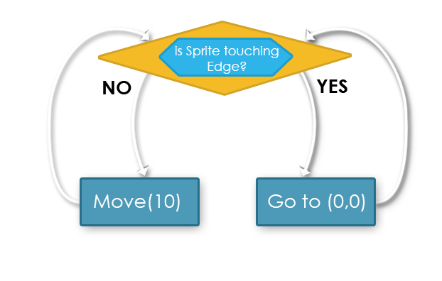
IF - ELSE
Define two separate branches:
One for when the condition is TRUE
Another for when it is FALSE

Slide 6
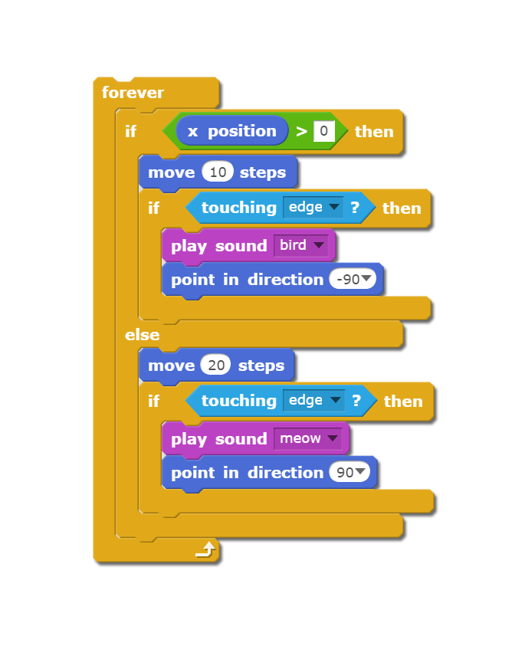
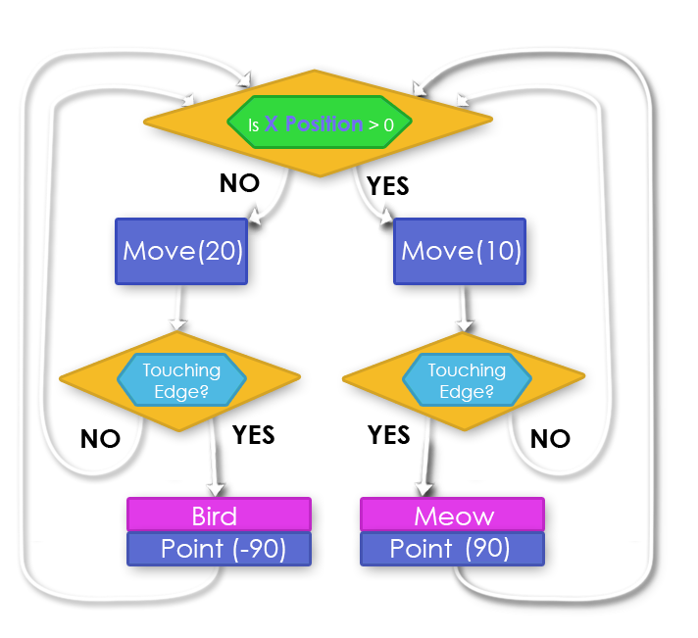
Combining IFs
NESTED CONDITIONS
IF and IF-ELSE blocks can be placed inside of other IF statements to create more complex logic.

